Slide 1



CAPSTONE PROJECT: Healthcare Analytics PGP DSE FEB 2019
Group-1 Members:
Hemanth Bugga
Lavina Dsouza
Makarand P Batchu
Vishal Gudla
Research Supervisor:
Mr. Srikar Muppidi

Slide 2
Objective For Analysis
The objective of our capstone project is to determine which treatments are most effective at treating diabetes.
Data Source: UCI.edu
Data Link: Capstone Project Data Link

Slide 3
Introduction
The study uses the data obtained from the center for machine learning and intelligent systems at university of California.
It contains clinical records from over 100,000 individual encounters corresponding to approximately 60,000 distinct patients.
The data was collected over a period of 10 years, from 1999 to 2008, and contains several attributes which correspond to the admission and discharge of patients.
These records contain information about various laboratory tests and procedures, diagnosis, and medications that were administered in the duration of the hospital stay.

Slide 4
Problem Statement
1A : The hospitals are evaluating efficiency of Insulin based treatment for patients. Recommend if solo insulin treatments work well towards the above stated objective
1B : For a new patient, given his medical history and characteristics, should we recommend solo insulin or a conjunction of other drugs/ treatment?

Slide 5
Dataset Information
Lab Session Details
Encounter_id | Unique identifier of an encounter
num_lab_procedures | Number of lab tests performed during the encounter
num_medications | Number of distinct generic names administered during the encounter
num_procedures | Number of procedures (other than lab tests) performed during the encounter
number_emergency | Number of emergency visits of the patient in the year preceding the encounter
number_inpatient | Number of inpatient visits of the patient in the year preceding the encounter
number_outpatient | Number of outpatient visits of the patient in the year preceding the encounter

Slide 6
2) Patient Details
patient_nbr | Unique identifier of a patient
age | Grouped in 10-year intervals: 0, 10), 10, 20), …, 90, 100)
Race | Values: Caucasian, Asian, African American, Hispanic, and other
Gender | Values: male, female, and unknown/invalid
Weight | Weight in pounds.
3) Diagnostic Session Details
Diagnosis_1 | The primary diagnosis (coded as first three digits of ICD9); 848 distinct values
Diagnosis_2 | Secondary diagnosis (coded as first three digits of ICD9); 923 distinct values
Diagnosis_3 | Additional secondary diagnosis (coded as first three digits of ICD9); 954 distinct values
number_diagnoses | Number of diagnoses entered to the system

Slide 7
4) Admission Details of Patients
admission_source_id | Integer identifier corresponding to 9 distinct values, for example, emergency, urgent, elective and not available
discharge_disposition_id | Integer identifier corresponding to 29 distinct values, for example, discharged to home, expired, and not available
admission_source_id | Integer identifier corresponding to 21 distinct values, for example, physician referral and transfer from a hospital
time_in_hospital | Integer number of days between admission and discharge
Payer_code | Integer identifier corresponding to 23 distinct values, for example, Blue Cross/Blue Shield, Medicare, and self-pay
Medical_speciality | Integer identifier of a specialty of the admitting physician, corresponding to 84 distinct values, for example, cardiology, internal medicine, family/general practice, and surgeon

Slide 8
5) Diabetic Data of Patients
max_glu_serum | Indicates the range of the result or if the test was not taken. Values: “>200,” “>300,” “normal,” and “none” if not measured
A1Cresult | Indicates the range of the result or if the test was not taken. Values: ‘>8’,’>7’,’normal’,’none’
Insulin and 22 other drugs | Values: “up” if the dosage was increased during the encounter, “down” if the dosage was decreased, “steady” if the dosage did not change, and “no” if the drug was not prescribed
Change | Indicates if there was a change in diabetic medications (either dosage or generic name). Values: “change” and “no change”
DiabetesMed | Indicates if there was any diabetic medication prescribed. Values: “yes” and “no”
Readmitted | Days to inpatient readmission. Values: ‘<30’,’>30’ and ‘NO’

Slide 9
Data Pre-processing
Merging & Filtering Data
Missing Value Treatment, Sparse Data and Feature Engineering
Outlier Detection & Treatment
Binning Subclasses
Exploratory Data Analysis
Extracting Insights using Tableau
Answering Problem Statement (1a)
Model Building
Baseline Model
More Feature Engineering & Statistical Tests
Building Classification Models
SMOTE
Ensemble Techniques and Metric Comparison

Slide 10
Data Pre-processing

Slide 11
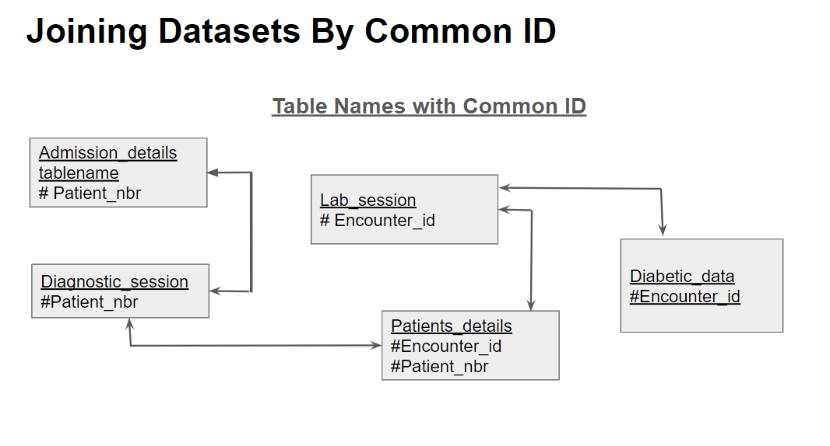
Merging Data
We were provided with 5 different datasets i.e Admission_details, Diabetic_data, Diagnostic_session, Lab_session and Patient_details. Let’s see that below.

Slide 12
2. Filtering data
The original dataset consists of 1,01,766 records.
We selected data that had ‘diabetesMed’ = ‘Yes’ which meant diabetes medicine was prescribed.
We removed records which had discharge_disposition_id as ‘expired’, ‘expired at home’ and ‘expired at medical facility’

Slide 13
3. Missing Values, Sparse Data & Feature Engineering
Categorical features having missing values (< 10%) were replaced with mode. (race,gender)
When there was no clear mode, missing values were imputed with class name ‘missing’ wording for categorical variables.
Features with high number of missing values (> 40%) were dropped. (weight, payer_code, medical_specialty)
None of the numerical features had missing values.
In order to reduce the dimensionality of our data, we implemented feature engineering to extract two new columns. (Total_Drugs, Solo_Insulin)

Slide 14
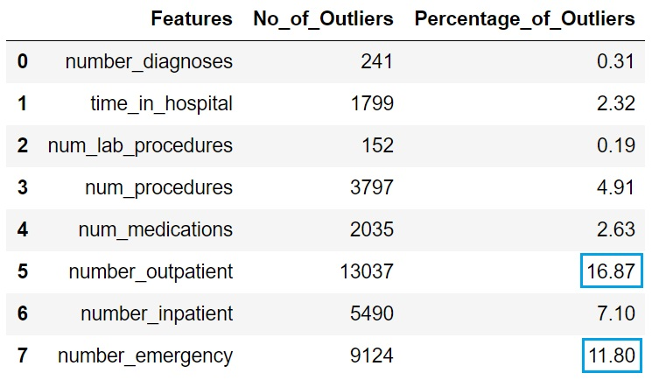
4. Outlier Detection & Treatment
We can see that highest number of outliers are present in number_outpatient as 16.87% and number_emergency as 11.80%

Slide 15
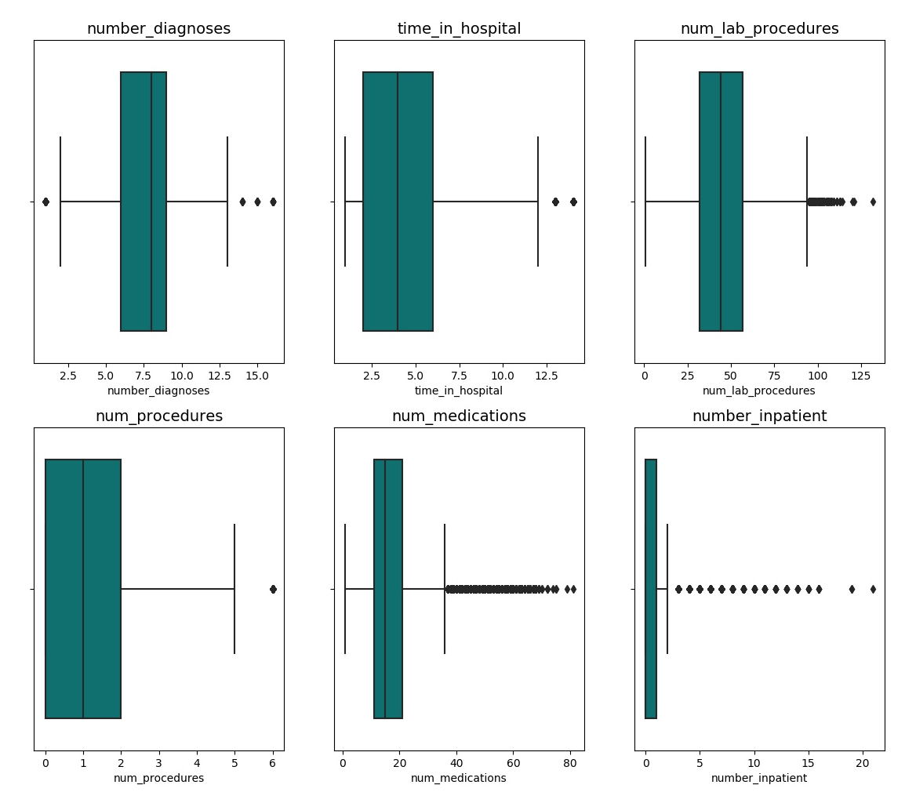
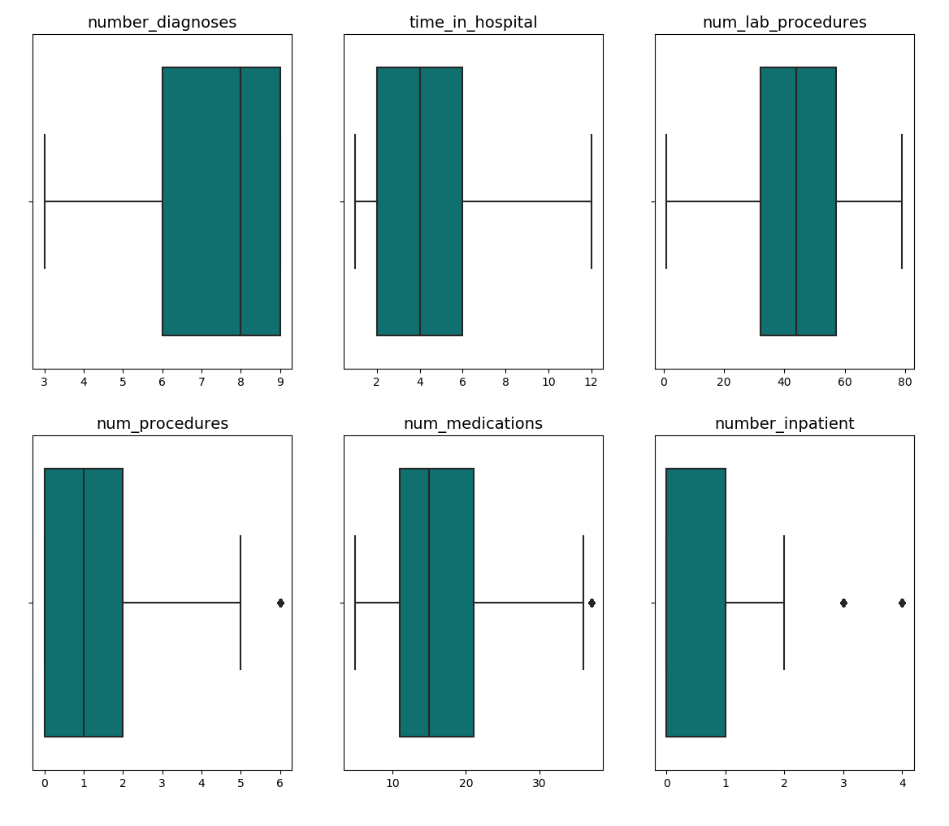
After Outlier Treatment
(using Winsorizer)
Before Outlier Treatment

Slide 16
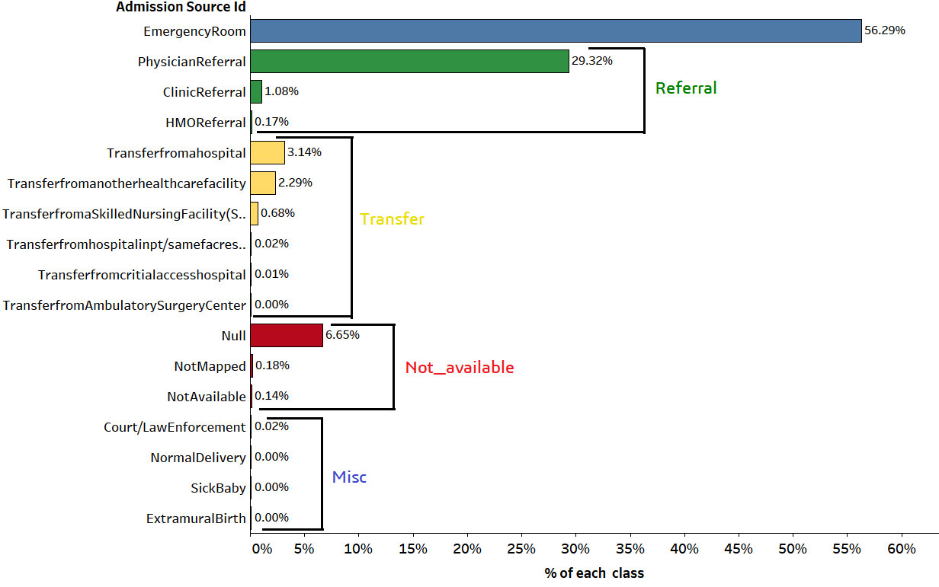
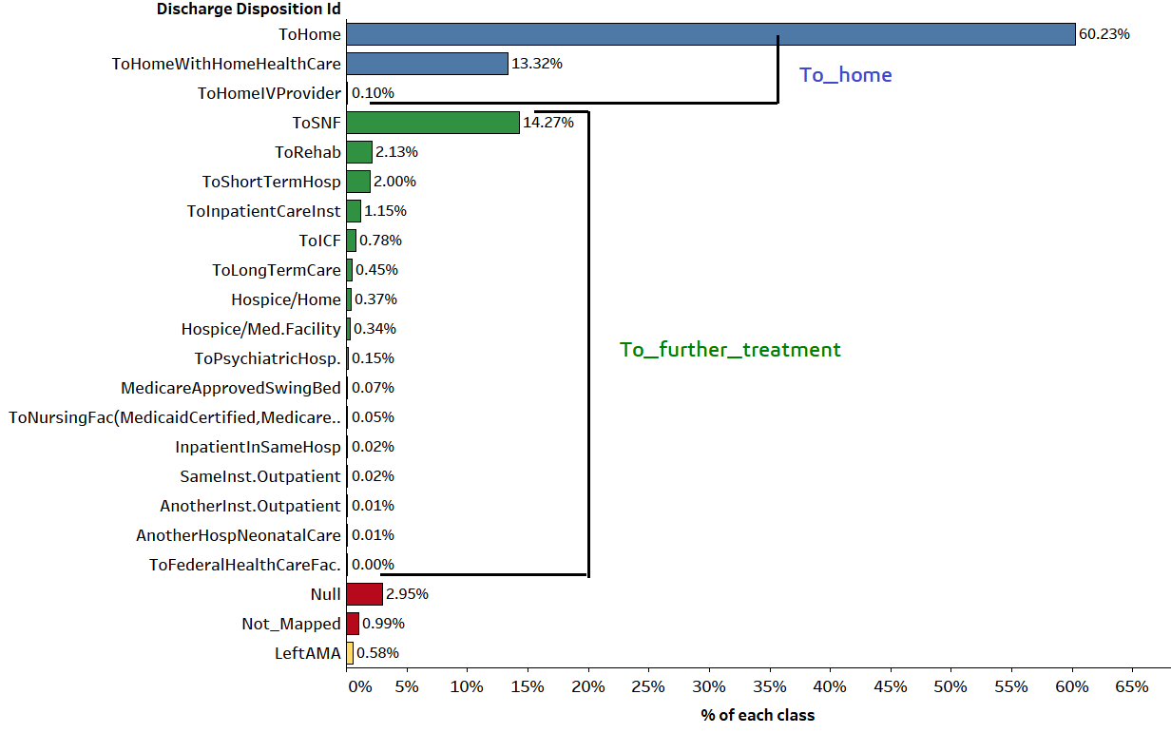
5. Binning Subclasses
Admission Source Id
Discharge Disposition Id

Slide 17
Exploratory Data Analysis

Slide 18
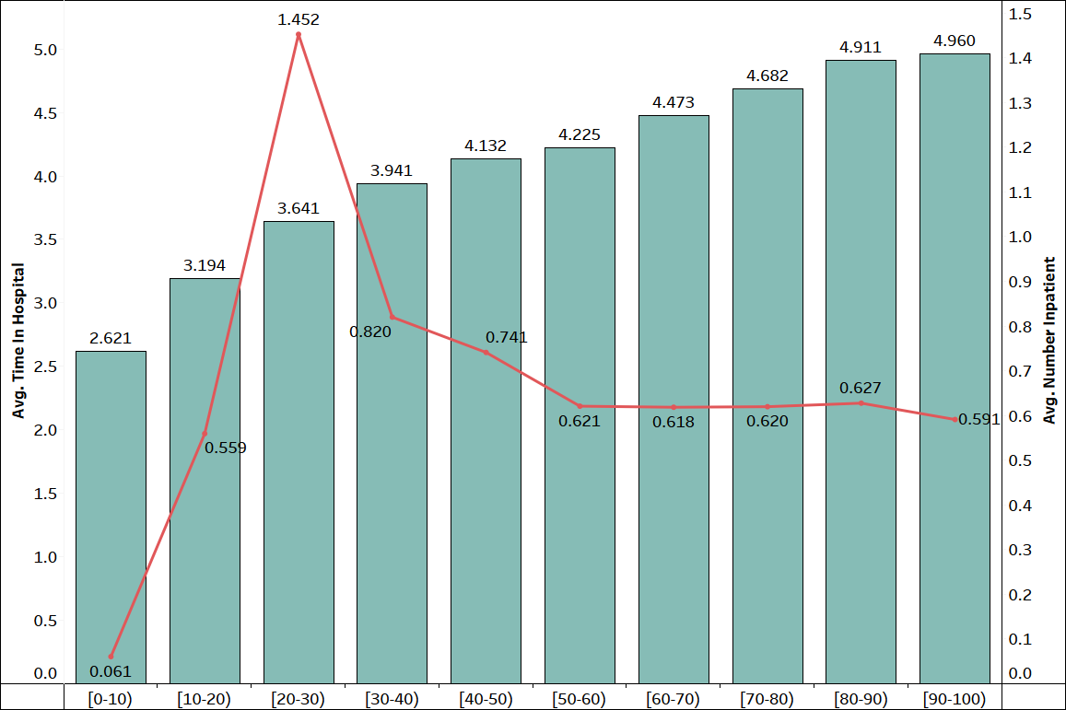
Insights
Blue bars represent the average time spent in hospital
Red line plot indicates the average number of inpatients
Average no.of inpatients under the age group 20-30 years are almost twice that of any age group over 40 years(but we don’t have enough data or domain knowledge that helps us to understand this behavior).
Whereas the avg time spent in the hospital is increasing w.r.t patients age (this is possibly that older people requires more care than younger ones).

Slide 19
The following insights are comparisons between Diabetic and Non-Diabetic encounters and can help a hospital plan its resources in a better way based on the patient’s age and his/her diabetic status.

Slide 20
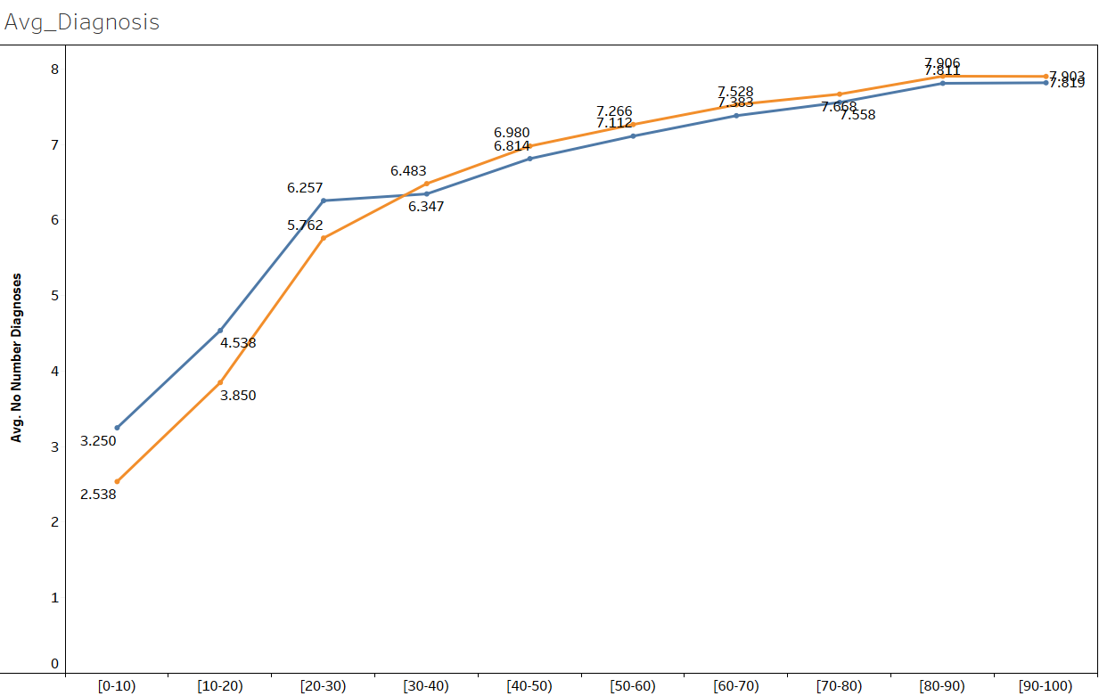
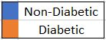
Average number of Diagnosis
Both cases show an upward trend up to 50 years of age after which average number of diagnosis remain constant in both cases (close to 8 diagnoses on average).

Slide 21
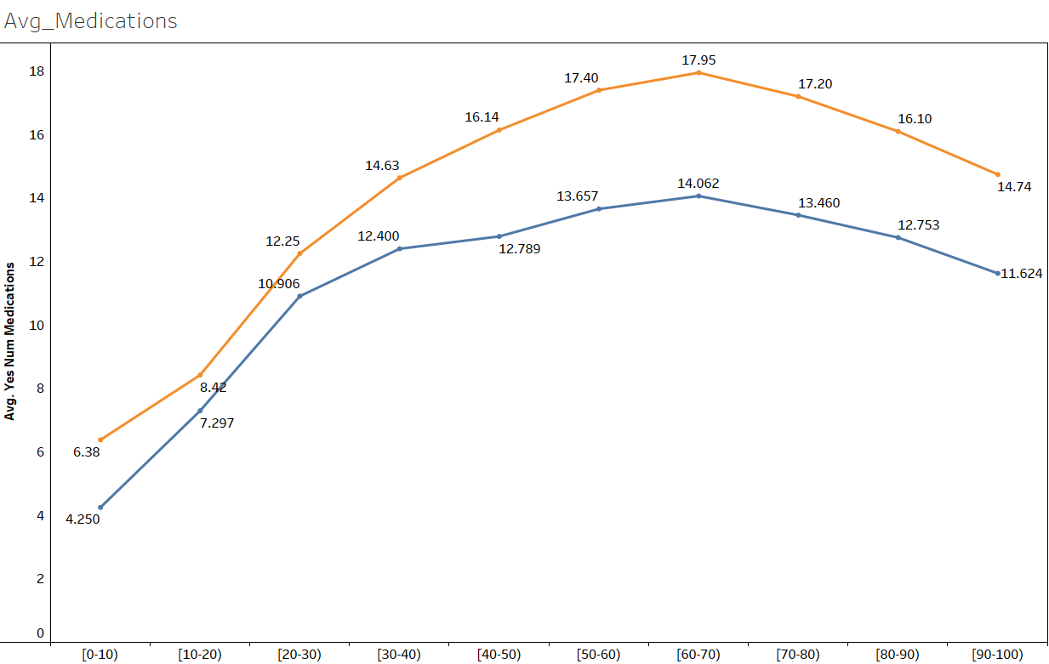
Average number of Medications:
Highest average number of medications occur for age groups of 50-70 years in both cases.
Highest average number of medications for diabetic patients(18 medicines on avg) is 30% more than highest average
number of medications for non-diabetic patients(15 medicines on avg).
After 70 years, the average number of medications shows a downward trend in both cases.

Slide 22
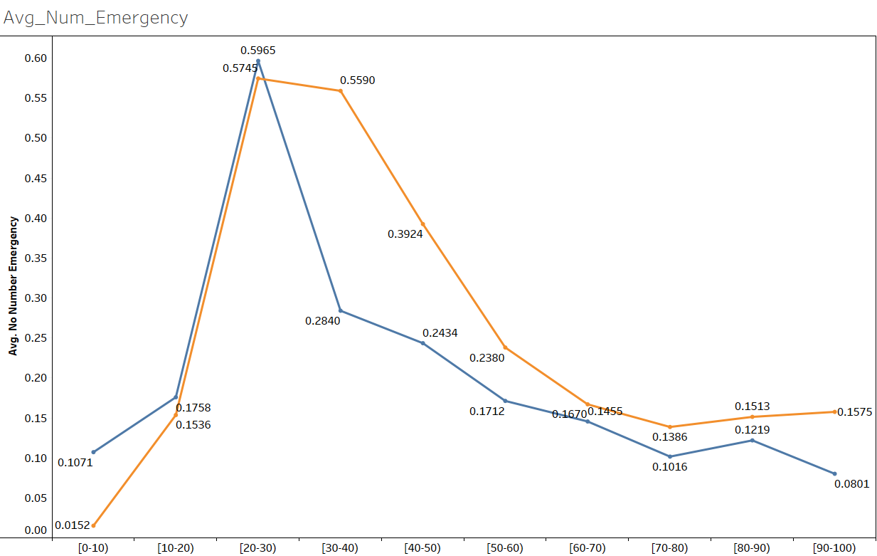
Average number of Emergencies:
Average number of emergencies are maximum for age group of 20-30 years in both cases.
From 30 years, average number of emergencies shows a downward trend and then become constant.

Slide 23
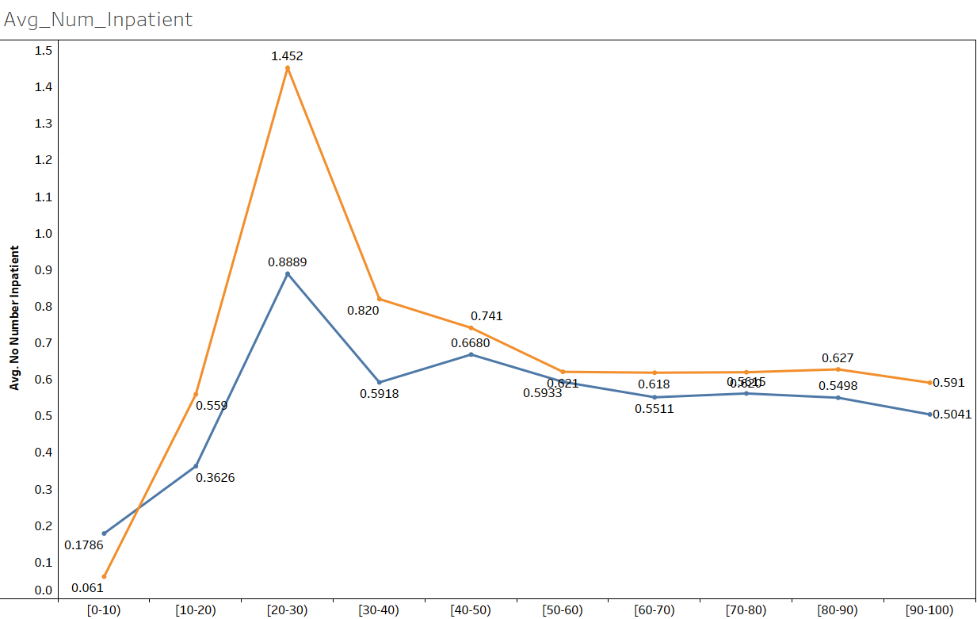
Average number of Inpatients:
Average number of inpatients are highest for age group of 20-30 years in both cases (close to 2 inpatient visits).
Highest number of average inpatients in diabetic patients is 65% more than highest number of average inpatients in non-diabetic patients.
From 50 years, the average number of inpatients become constant in both cases (0.6-0.8).

Slide 24
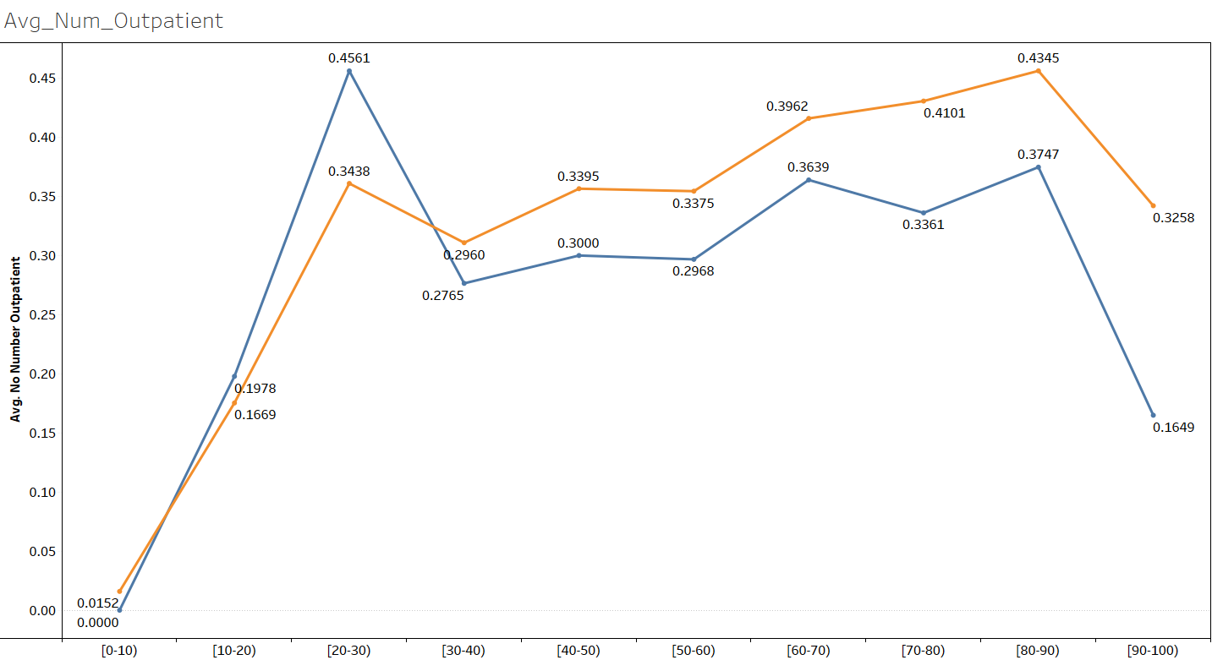
Average number of Outpatients:
For diabetic patients, highest average number of outpatients appear at age group of 80-90 years.
For non-diabetic patients, highest average number of outpatients appear at age group of 20-30 years.

Slide 25
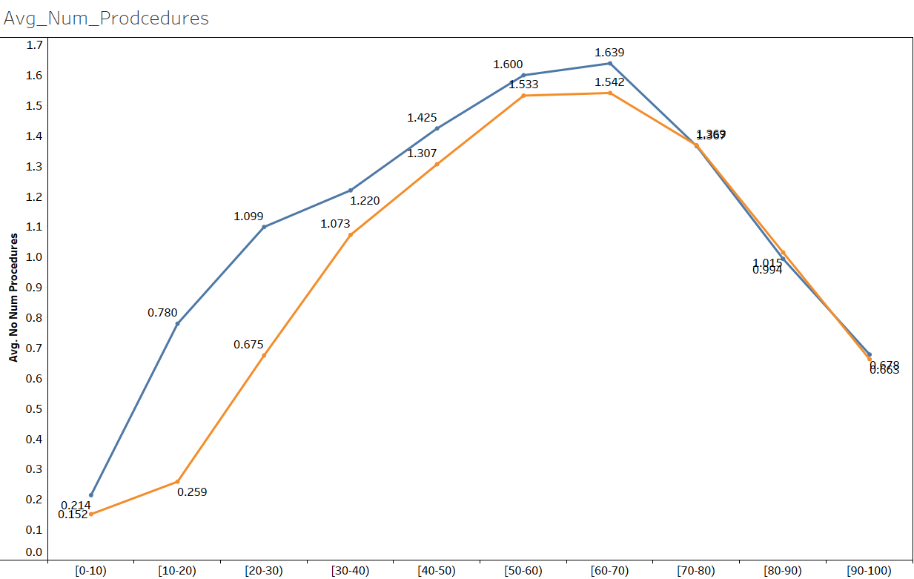
Average number of Procedures:
Highest average number of procedures appear at age group of 60-70 years in both cases.
Beyond 70 years there is sharp drop in average number of procedures.

Slide 26

Efficiency of drugs
Answering Problem Statement (1a)
Feature : ‘readmitted’
Classes : ‘>30 days’,’<30 days’, ‘NO’
Efficiency of Solo-Insulin = 49.6 %
Efficiency of Combination of Drugs (Total Drugs > 1) = 52.8 %
Efficiency of Other Drugs = 52.9 %
Efficiency of any Single Drug = 60.1 %
Efficiency of any Single Drug (excluding insulin) = 68.1%

Slide 27
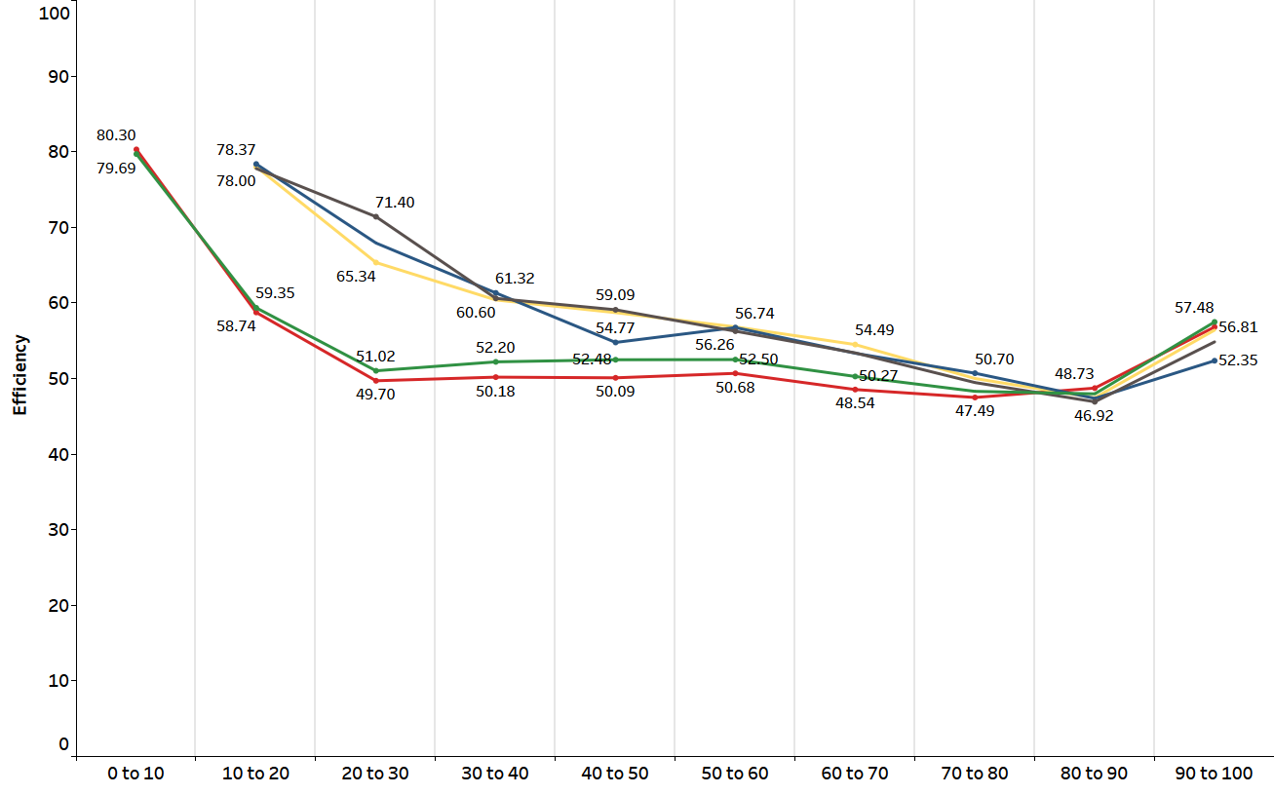
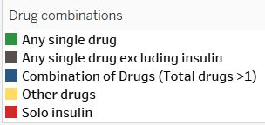
Efficiency of Drugs with respect to Age

Slide 28
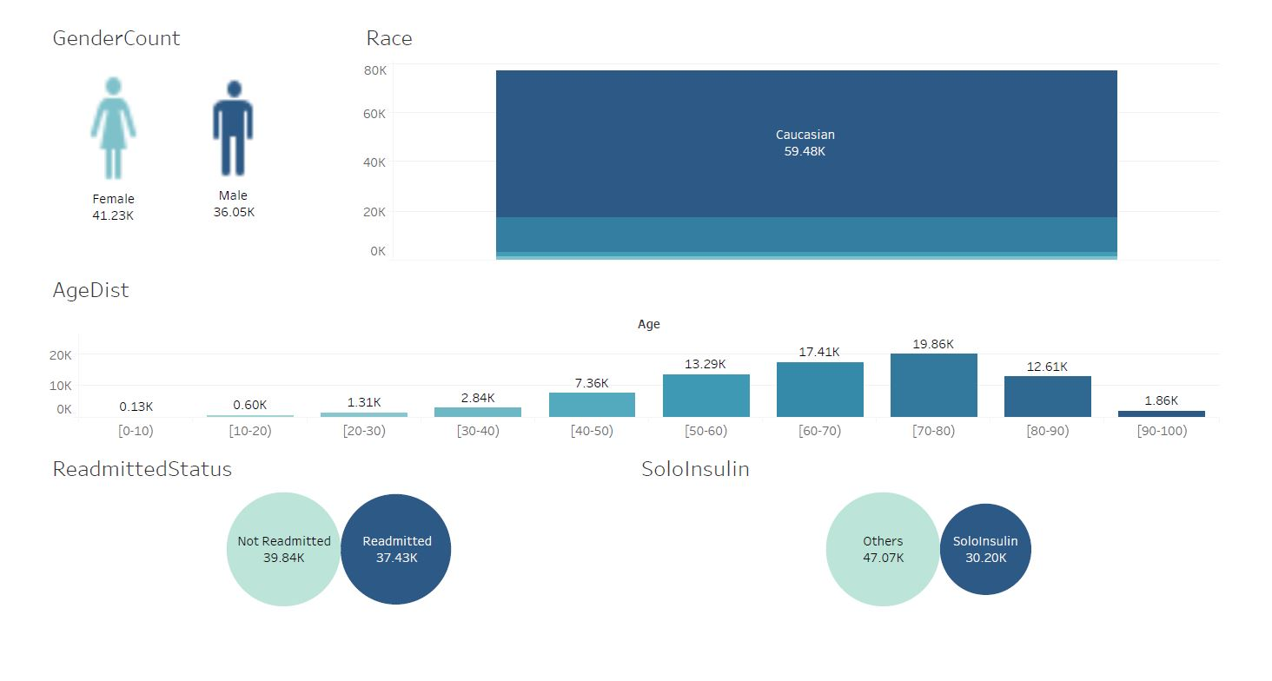
Patient Demographic Dashboard

Slide 29
Insights from Patient Demographic Dashboard
1. For ages 0-40 years, 70% people take SoloInsulin i.e. they have Type-I Diabetes. For ages above 40 years, 65% people take other drugs(other drugs Or SoloInsulin+other drugs) i.e. they have Type-II Diabetes.
2. SoloInsulin as well as Other drugs were used maximum by patients in the age group : 70-80 years.
3. For all age groups, the number of 'not readmitted' encounters are greater than 'readmitted' ones except in age group : 70-90 years

Slide 30
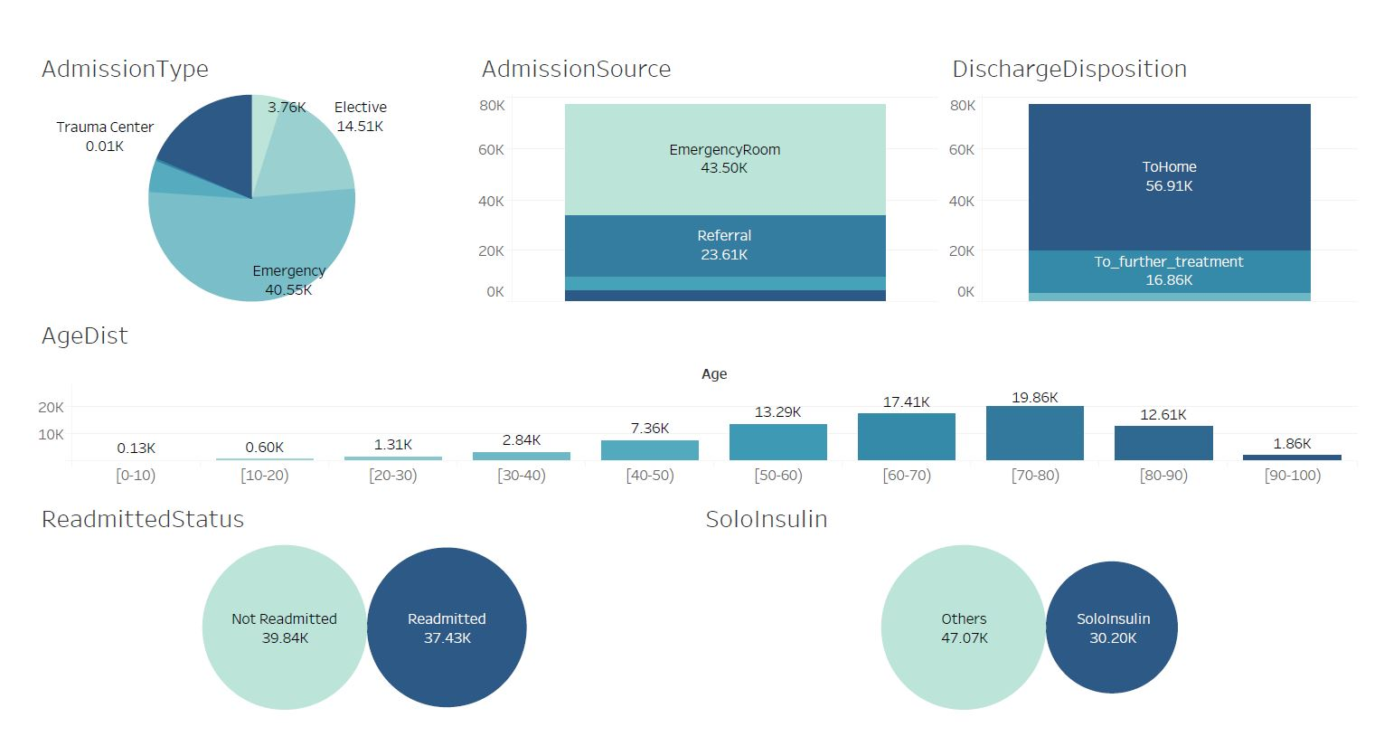
Admission & Discharge Dashboard

Slide 31
Insights from Admission & Discharge Dashboard
1. In Admission Type - 'Emergency','Elective' and 'Urgent', close to 40% of encounters are taking SoloInsulin i.e. Type-I Diabetic.
2. Only for AdmissionSource : 'EmergencyRoom' number of 'Readmitted' encounters>number of 'Not Readmitted' encounters. For all other Admission Sources it is vice versa meaning they are cured of diabetes.
3. For DischargeDispositionID as 'ToHome' and 'ToFurtherTreatment', approx. 50% of encounters were 'Readmitted' .

Slide 32
Model Building

Slide 33
Baseline Model
Target Feature: Solo insulin [binary classification]
Model implemented: Logistic Regression
Parameters: random_state : 1
test_size : 0.2
Results: Accuracy : 60.91 %
AUC : 0.5

Slide 34
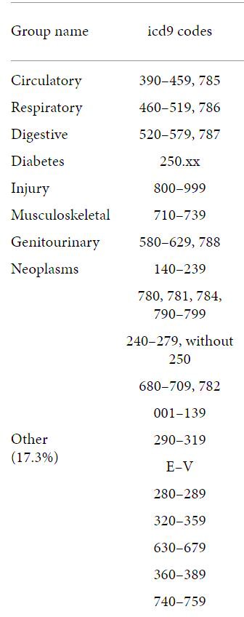
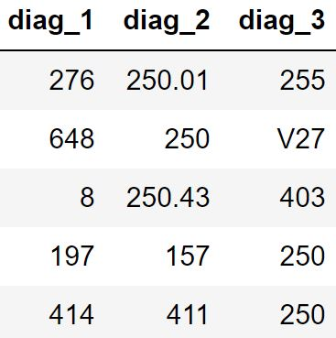
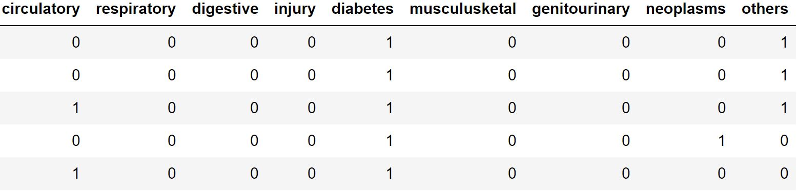
2. More Feature Engineering
Binary Subclasses (Diagnosis - 0,1)
Multiple Subclasses (Circulatory, Injury Digestive, etc)
ICD9 CODES
Diagnosis 1,2 & 3

Slide 35
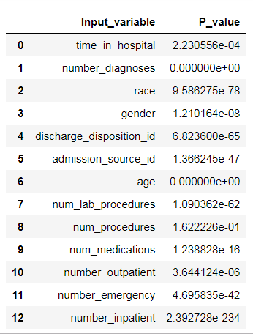
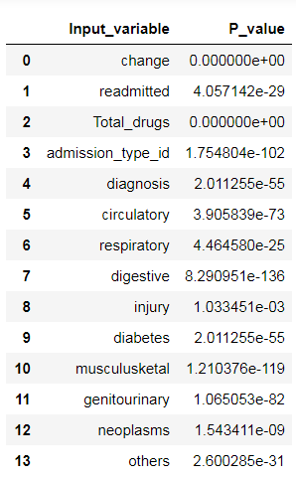

Statistical Tests
H0: Coefficient = 0
H1: Coefficient != 0
Binary
Multiple

Slide 36
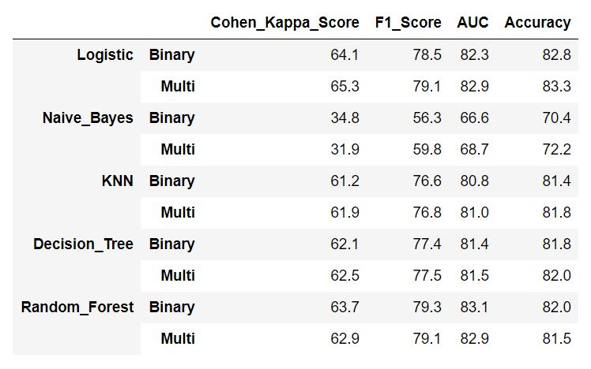
3. Building Classification Models
Note: For KFold K=5

Slide 37
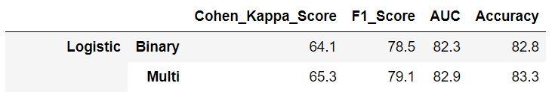
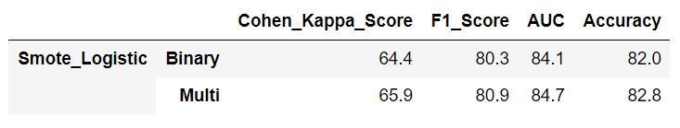
4. SMOTE(Synthetic Minority Oversampling Technique)
Without SMOTE
2. With SMOTE

Slide 38
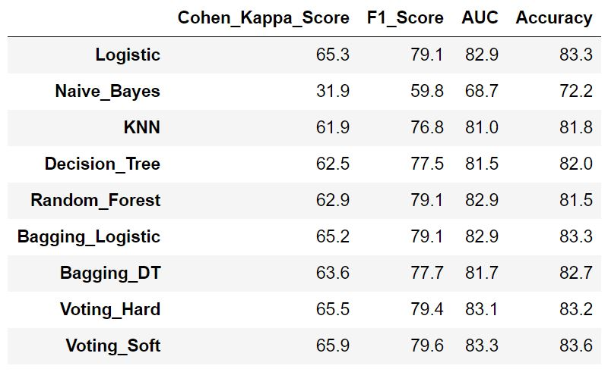
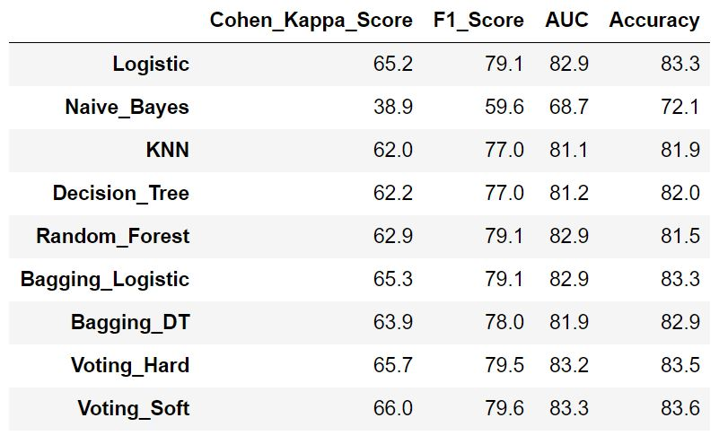
5. Ensemble Models and Metric Comparison
Number of folds =5
Number of folds =10

Slide 39
Conclusions
When compared to any combination of drugs, any drug given exclusively showed the highest efficiency (i.e. 68%) in treating diabetes.
Among all our models, Soft Voting Classifier and Logistic regression yield the best performance.
Logistic Regression being a simpler algorithm and much more interpretable, we would recommend it for suggesting one of the two treatments to future patients.

Slide 40


